Slide 1
Graph Databases
Jose Andrés Campos Castro
Roberto Gutiérrez Sánchez

Slide 2
Agenda
Graphs
Types of graphs.
History of Graph Databases.
DBMS Examples.
Graph Databases in Neo4j.
Example.

Slide 3
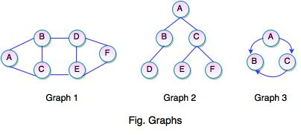
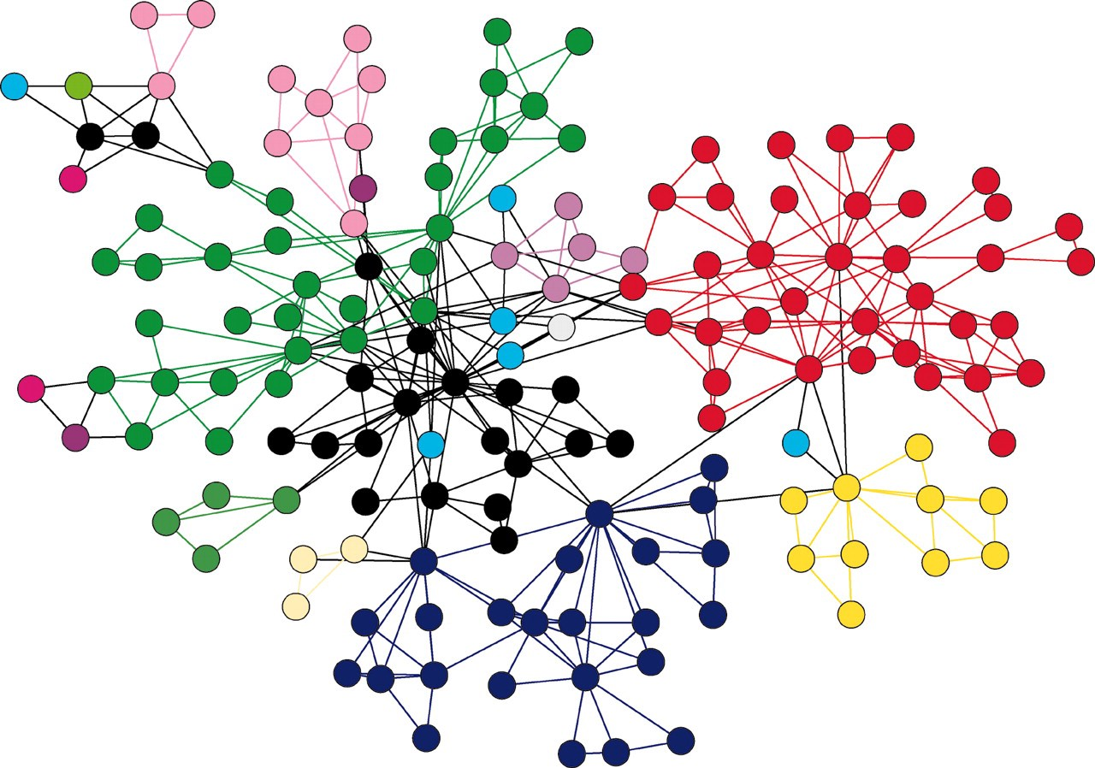
Graphs

Slide 4
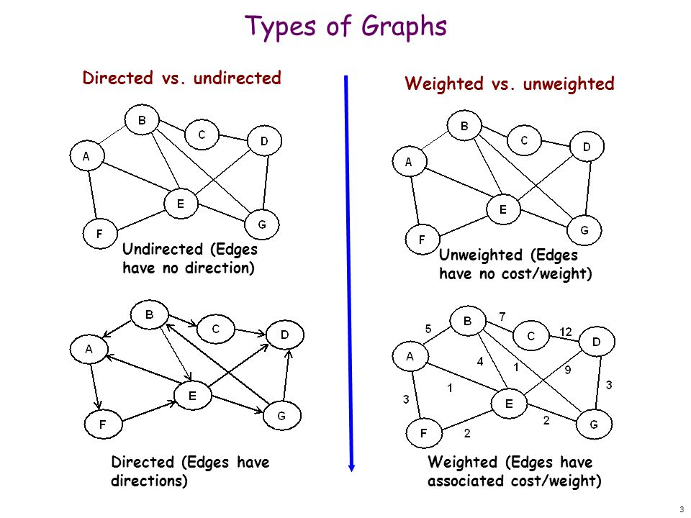
Types of Graphs

Slide 5
History of Graph Databases
70’s → Tabular Databases
80’s → Relational Databases
90’s → NoSQL.
BASE | ACID
Basic Availability | Atomic: Everything in a transaction succeeds or the entire transaction is rolled back.
Soft-state | Consistent: A transaction cannot leave the database in an inconsistent state.
Eventual consistency | Isolated: Transactions cannot interfere with each other.
 | Durable: Completed transactions persist, even when servers restart etc.

Slide 6
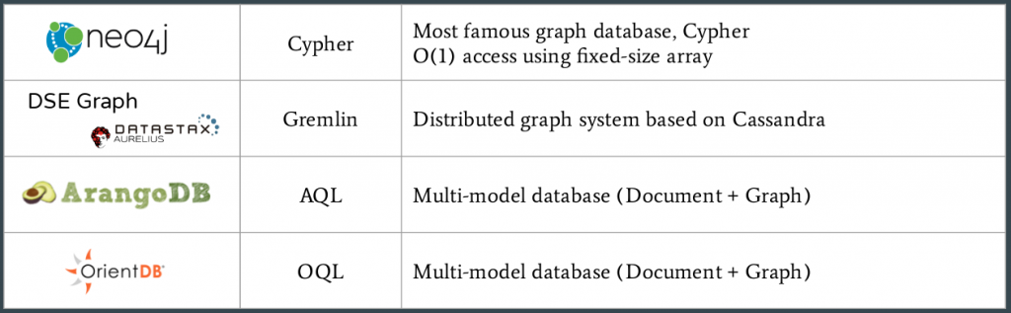
DBMS Examples.

Slide 7
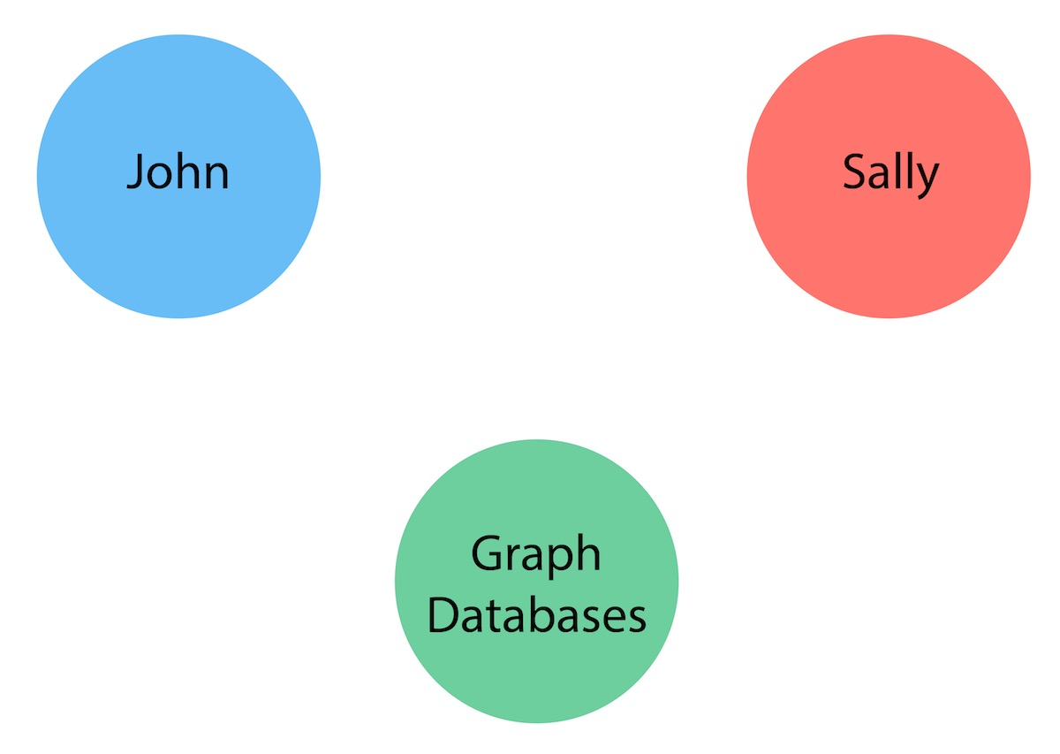
Graph Databases in Neo4j.
Nodes The first entities that we will identify in our domain are the nodes. Nodes are one of two fundamental units that form a graph (the other fundamental unit is relationships). Nodes are often used to represent entities, but can also represent other domain components, depending on the use case.

Slide 8
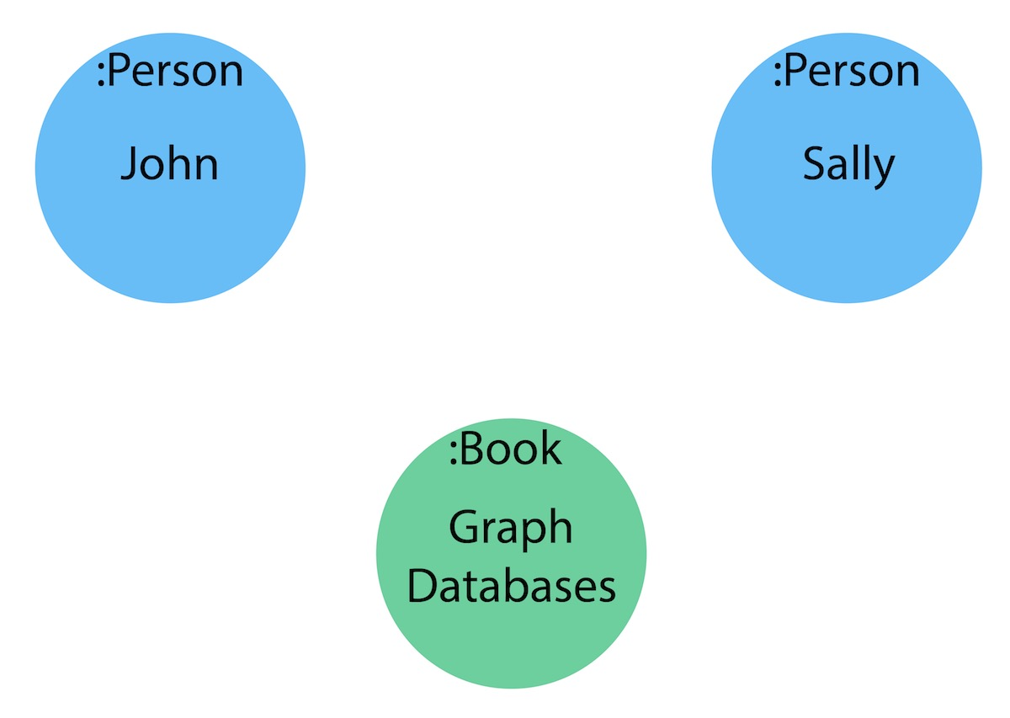
Graph Databases in Neo4j.
Labels Now that we have an idea of what our nodes will be, we can decide what labels (if any) to assign our nodes to group or categorize them.
A label is a named graph construct that is used to group nodes into sets. All nodes labeled with the same label belongs to the same set.

Slide 9
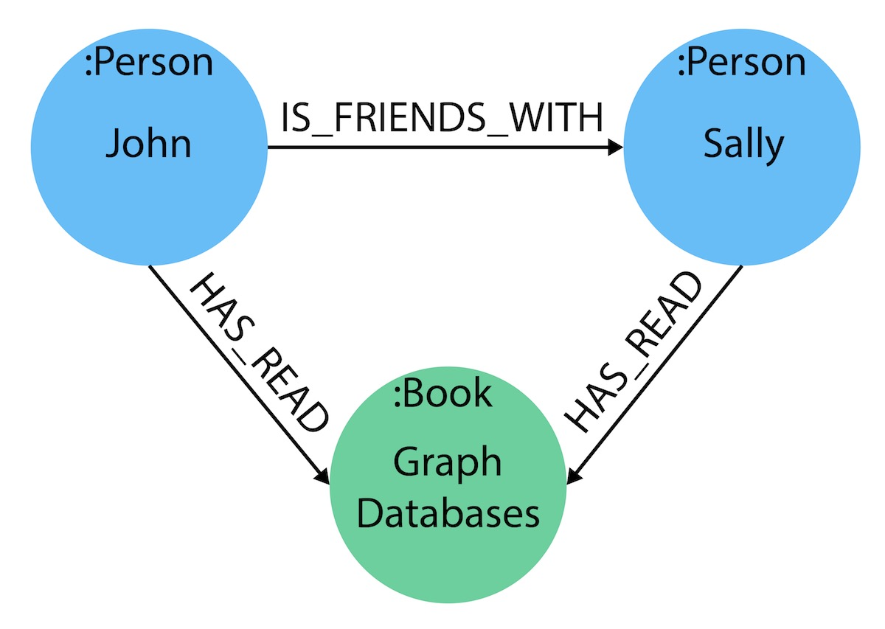
Graph Databases in Neo4j.
Relationships
A relationship connects two nodes and allows us to find related nodes of data. It has a source node and a target node that shows the direction of the arrow.

Slide 10
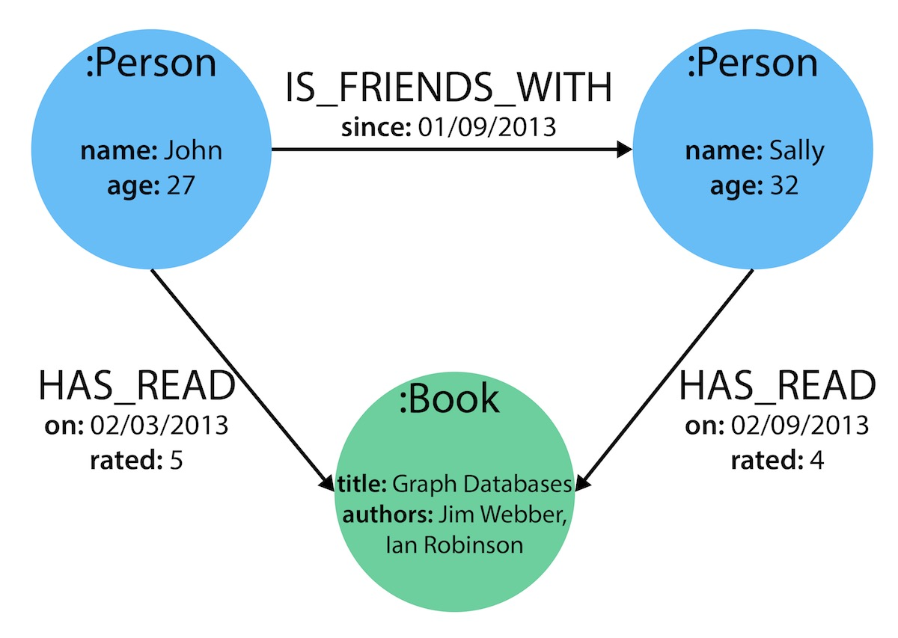
Graph Databases in Neo4j.
Properties
Properties are name-value pairs of data that you can store on nodes or on relationships. Most standard data types are supported as properties.
Properties allow you to store relevant data about the node or relationship with the entity it describes. They can often be found by knowing what kinds of questions your use case needs to ask of your data.

Slide 11
Example
https://github.com/campos-97/GraphDBExample
https://neo4j.com/download/

Slide 12
Bibliography
"History of Databases and Graph Database - Bitnine Global Inc.", Bitnine Global Inc [Online]. Available: https://bitnine.net/blog-graph-database/history-of-databases-and-graph-database/. [Accessed: 7- Oct- 2018].
"Impossible Is Nothing: The History (& Future) of Graph Data [GraphConnect Recap] - Neo4j Graph Database Platform", Neo4j Graph Database Platform. [Online]. Available: https://neo4j.com/blog/history-and-future-of-graph-data/. [Accessed: 7- Oct- 2018].
"Relational Databases vs. Graph Databases: A Comparison", Neo4j Graph Database Platform .[Online]. Available: https://neo4j.com/developer/graph-db-vs-rdbms/. [Accessed: 7- Oct- 2018].
J. Cook, "ACID versus BASE for database transactions", Johndcook.com. [Online]. Available: https://www.johndcook.com/blog/2009/07/06/brewer-cap-theorem-base/. [Accessed: 7- Oct- 2018].

